Slide 1
The School Presentation of Mrs. Galan Class

Slide 2
Names
Goofy
Goofyhead
Goofyface
Chipmunks
Chipmunkshead
Chipmunkface
Pig
Pighead
Pigface
Birdie
Cat
Squrriel/Squrrielhead
Bee
Chicken/Chickenhead

Slide 3
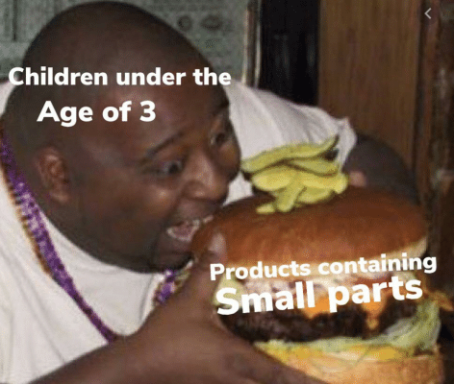
Amy
Color Shiny Day

Slide 4

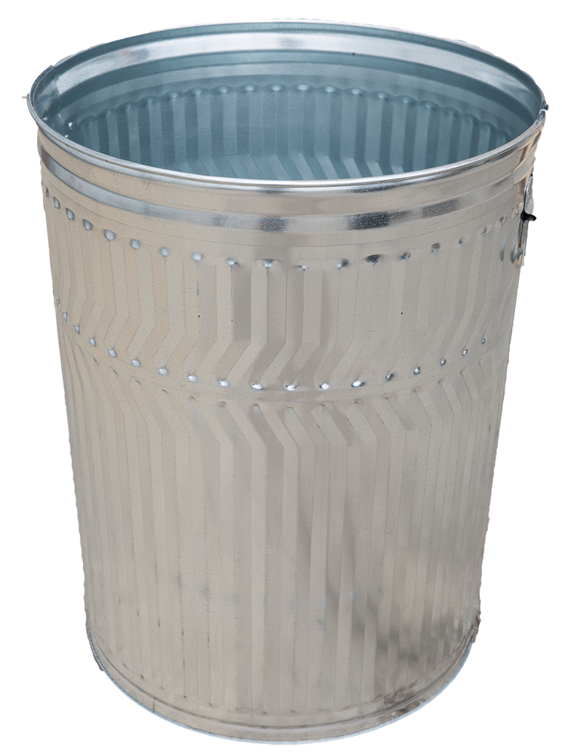

Slide 5


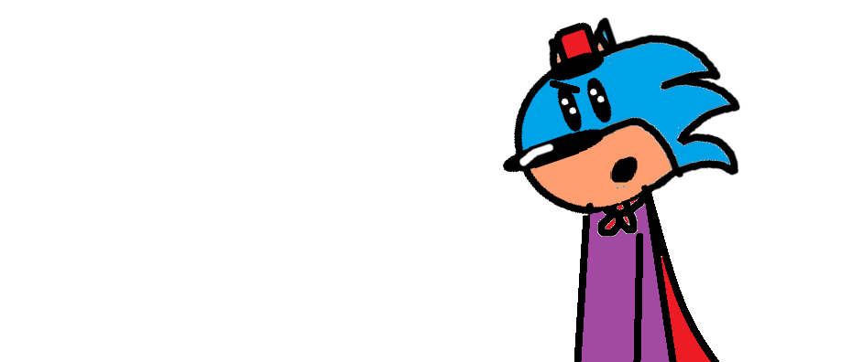

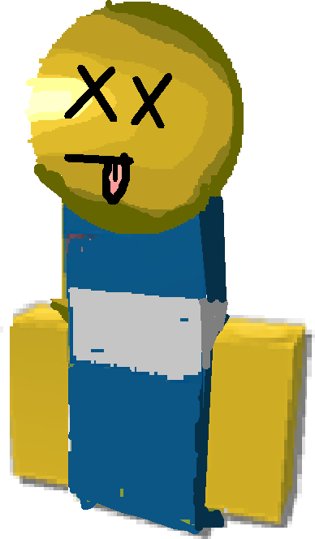


Slide 6
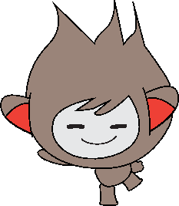
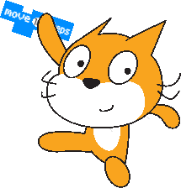

Slide 7
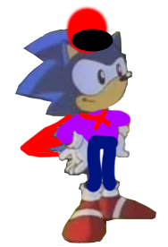
?

Slide 8
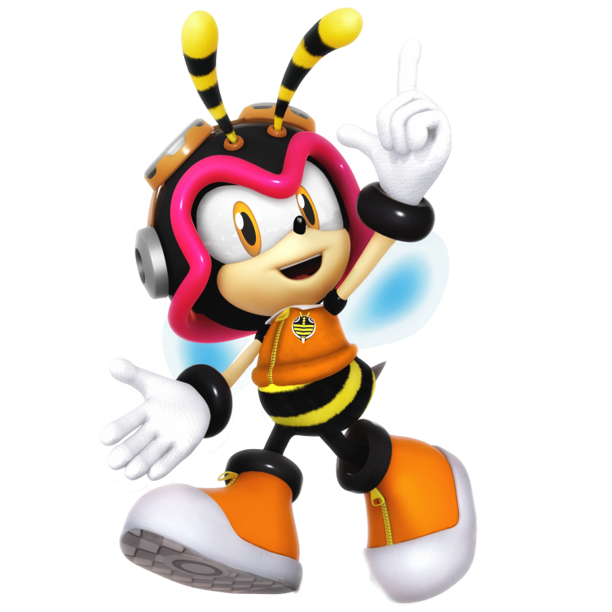

Slide 9

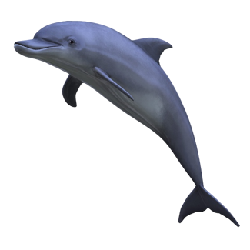

Slide 10
Replay

